Slide 1
Impacts of COVID-19 Vaccination Status
Group 2: Andrew Fisher - Sierra Gomez - Waynette Burke - Zane Rios - Jeanne Darkoury

Slide 2




Hypothesis
Null Hypothesis:
There is no difference in the number of people death due to COVID-19 based on vaccination status.
Alternative Hypothesis:
The greater the vaccinated population there will be less death among this group.
Disclaimer: We do not seek to influence a person’s choice regarding the COVID-19 vaccines and boosters; we are only presenting our analysis of the data used.

Slide 3
About Our Topic
Vaccinations for the virus have saved millions of lives, but about half of all Covid-19 deaths in the US have happened over the past year – when vaccines were already widely available for everyone age 5 and older.
And though the government has not shared an official estimate of how many vaccinated people have died of Covid-19, a CNN analysis of CDC data shows that deaths in recent months have been much more evenly split between vaccinated and unvaccinated people as highly transmissible variants take hold, vaccine protection wanes and booster uptake stagnates.
But the risk of dying from Covid-19 is still about five times higher for unvaccinated people than it is for vaccinated people, according to the CDC.
*Our data is focused on the United States in 2021.

Slide 4
Questions
What are the COVID-19 Vaccination Status of the following demographics? What is the apparent outcome due to the virus?
Overall US Population – How much of the population is vaccinated and were the number of people reported dead due to COVID-19 higher for the vaccinated vs unvaccinated subset of the population?
Age – Is there a higher rate of death due to COVID -19 among a certain age group?
Sex – Is there a higher rate of death due to COVID-19 for men vs women?
Race/Ethnicity – Which group appears to be more at risk?
Pregnant Women – Are pregnant women less likely to be vaccinated than the general population?

Slide 5

Impacts of COVID Vaccination Status: United States
The United States started to feel the impacts of the COVID-19 virus at the beginning of 2020. With the case numbers increasing exponentially, there was a sense of urgency and vaccine creation, testing and production went into hyperdrive.
It was not until the beginning of 2021 that the distribution of the different types of vaccines were available to the general public.
From a United States perspective, our focus is not on the types of vaccines available but more on the number of persons vaccinated and whether the likelihood of being vaccinated reduced the number of deaths due to COVID-19 virus.

Slide 6
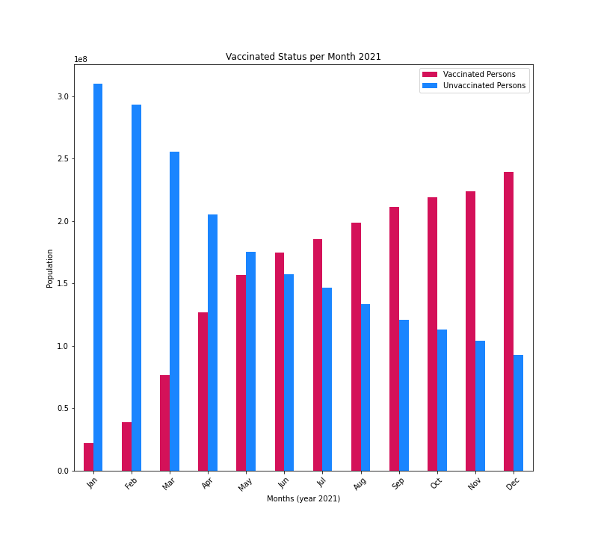
United States general population vaccination status (Jan - Dec 2021)
The bar chart shows an increase in the number of people getting vaccinated between January 2021 and Dec 2021.
Subsequently, the unvaccinated population decreased for the same time period.
(Population is represented in the millions.)

Slide 7
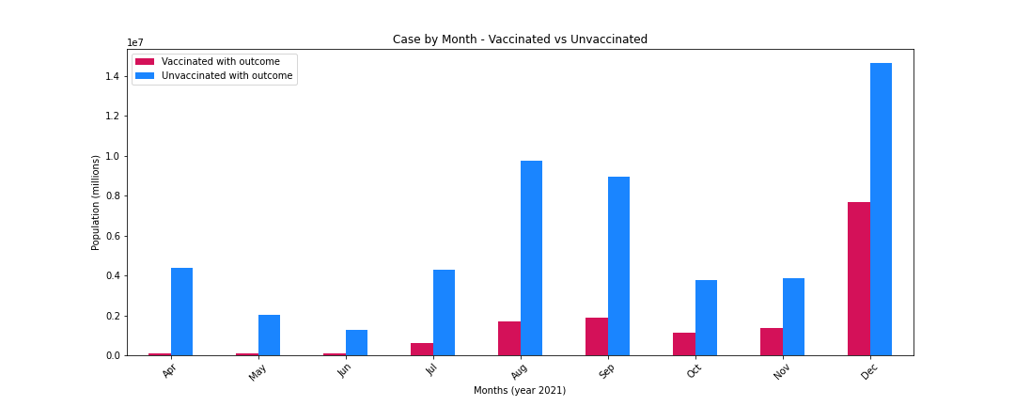
COVID Cases by vaccination status (Apr - Dec 2021)

Slide 8
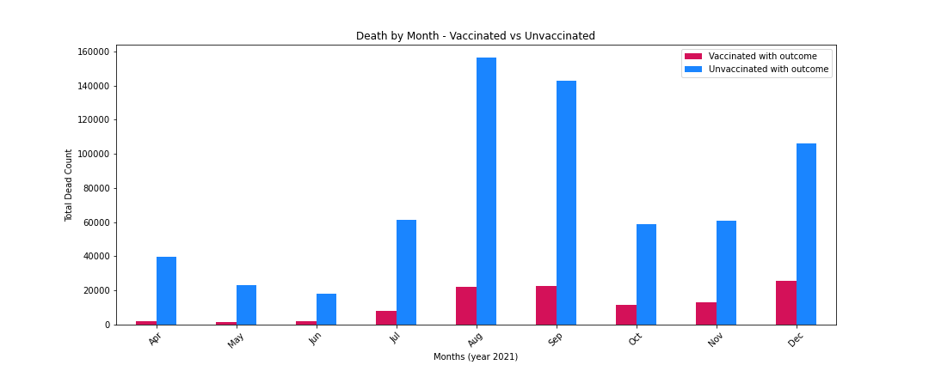
COVID Deaths by vaccination status (Apr - Dec 2021)

Slide 9
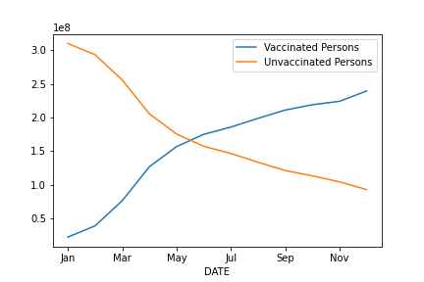
Analysis of COVID-19 Vaccination Status: United States
Summary Statistical Analysis for the United States:
From the 2021 data, there was no evidence in a plateau of the vaccination rate.
The correlation between the fully vaccinated and unvaccinated population is -1.0
The correlation between the fully vaccinated and unvaccinated death is 0.91.
Ttest results:
Ttest_indResult(statistic=-3.655805552976014, pvalue=0.00570508686987918)
The Ttest revealed that the null hypothesis can be rejected since the p-value is less than or equal to 0.05.

Slide 10

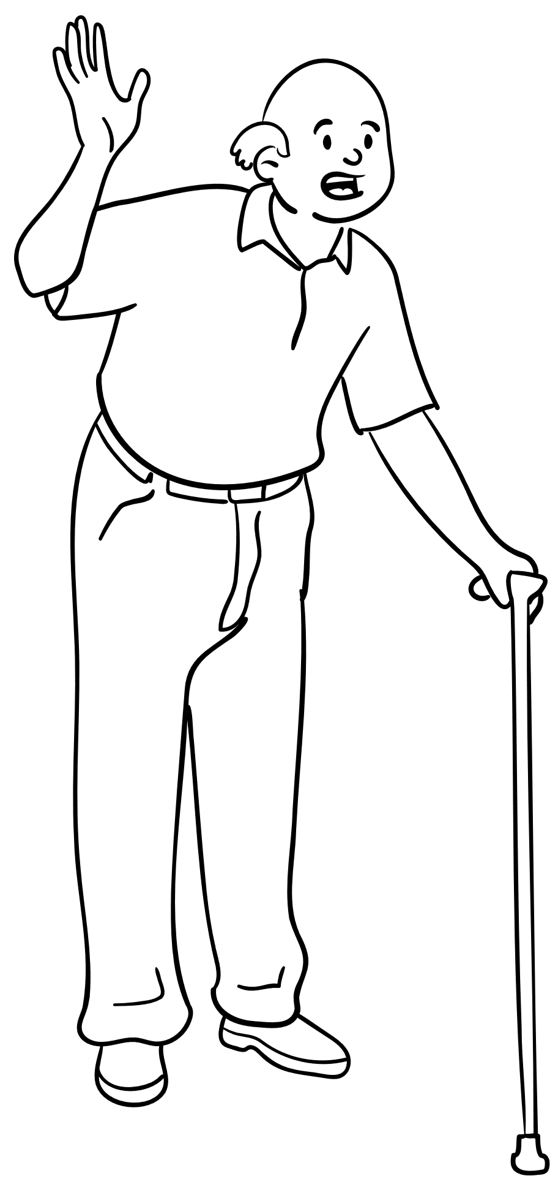
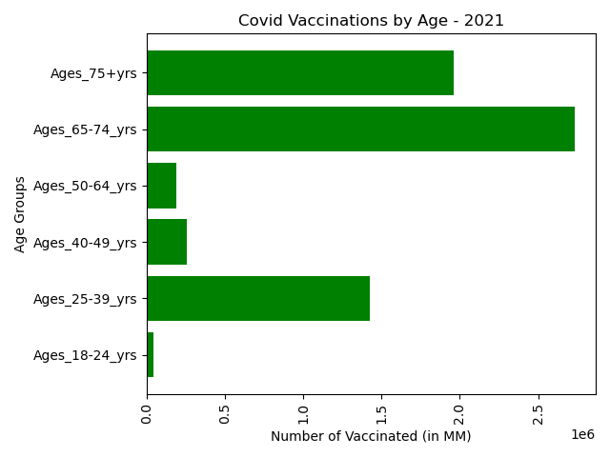
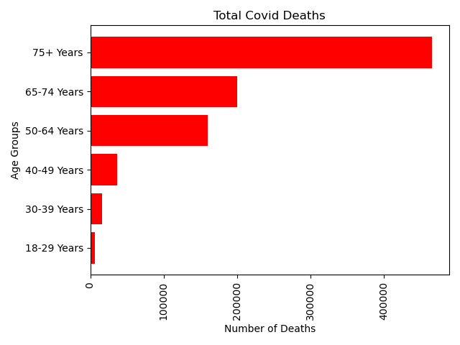
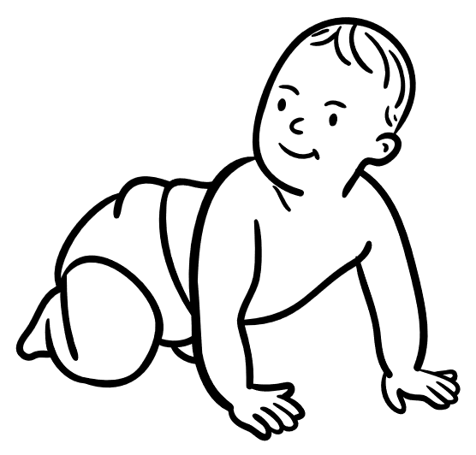
Impacts of COVID Vaccination Status: Age

Slide 11



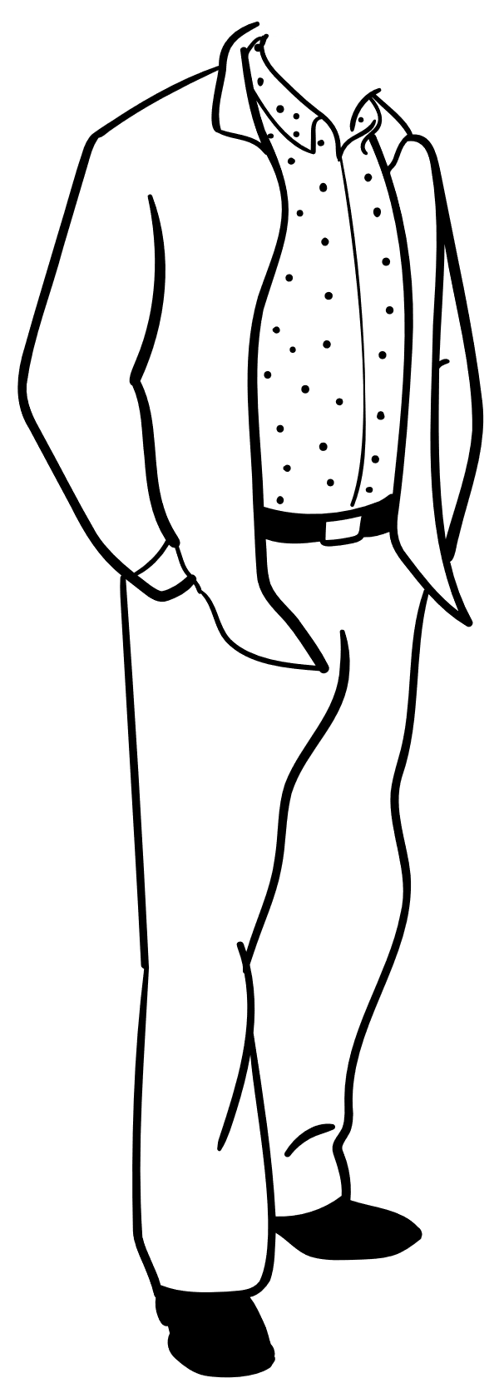
Impacts of COVID Vaccination Status: Sex

Slide 12


Impacts of COVID Vaccination Status: Pregnancy

Slide 13
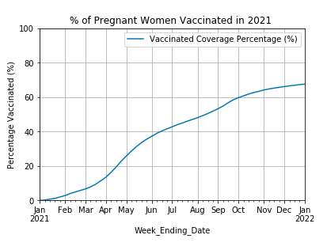
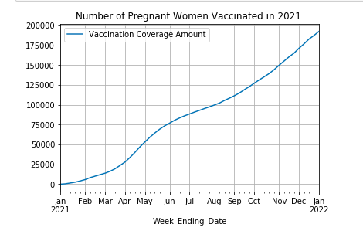
Impacts of COVID Vaccination Status: Pregnancy
Vaccinated Count: ~200,000 by the end of the 2022
Vaccinated Percentage: ~65% at the end of 2021

Slide 14
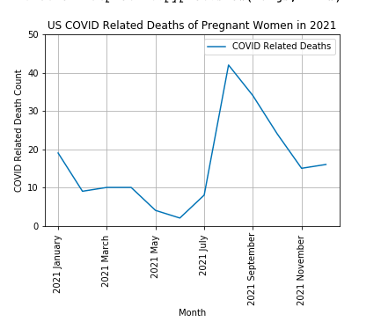
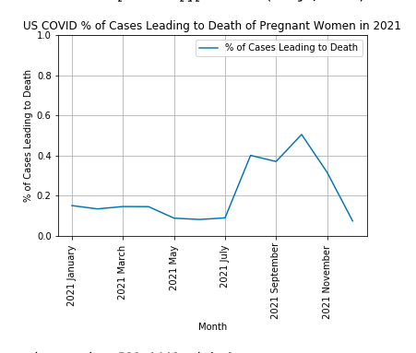
Impacts of COVID Vaccination Status: Pregnancy
COIVD Related Death Count
COVID Related Death Percentage

Slide 15
Analysis of COVID-19 Vaccination Status: Pregnant Women
Conclusion:
From the 2021 data, pregnant women are LESS likely to get vaccinated (67.6%) than the general American population (74.1%)
*A note regarding the data: The women included in this dataset were vaccinated at various points relating to their pregnancy. Some were vaccinated before they were pregnant, and others during the various stages of pregnancy.

Slide 16


Impacts of COVID Vaccination Status: Race / Ethnicity
The population breakdown of vaccinated people by race. According to the Center for Disease Control and Prevention, the US population % of White (Non-Hispanic) is (59.4%), Black or African American (Non-Hispanic) is (12.4%), Hispanic/Latino is (19.2%), American Indian (Non-Hispanic) is (0.7%), and Hawaiian (Non-Hispanic) is (0.3%).
In conclusion, according to this dataset:
White vaccinated people are LESS than the US white population.
Hispanic vaccinated people are MORE than the US Hispanic population.
Black vaccinated people are LESS than the US black population.
Hawaiian vaccinated people are EQUAL to the US Hawaiian population.
American Indian vaccinated people are MORE than the US American Indian population.

Slide 17
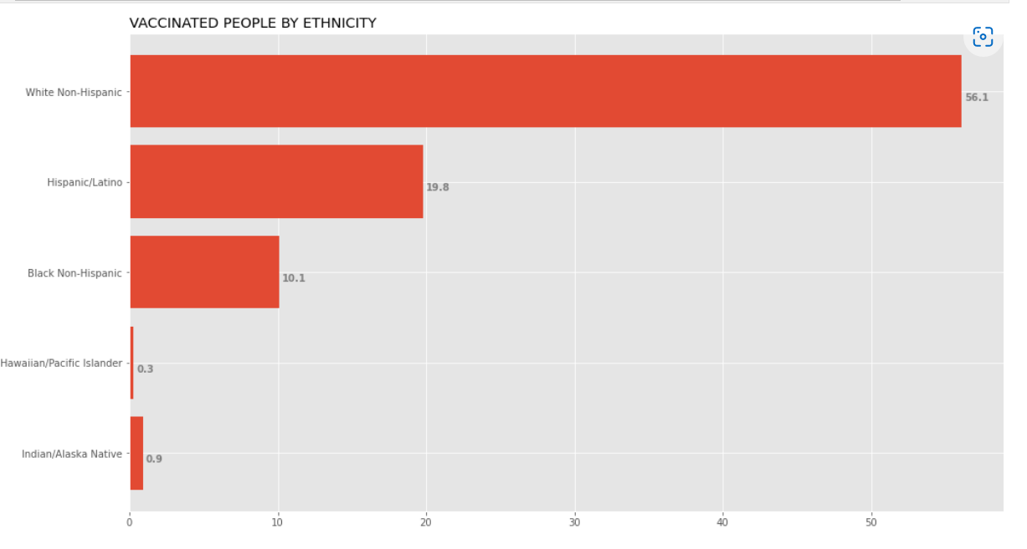
Vaccinated People by Ethnicity
We can see approximately 97875147 vaccinated people are White (~56.1%).
97875147 vaccinated people are White (~56.1%).
34579296 vaccinated people are Hispanic (~19.8%).
17689531 vaccinated people are Black (~10.1%).
569662 vaccinated people are Hawaiian (~0.3%).
1498047 vaccinated people are American Indian (~0.9%).
For a total of approximately 5 Races/Ethnicities represented.

Slide 18
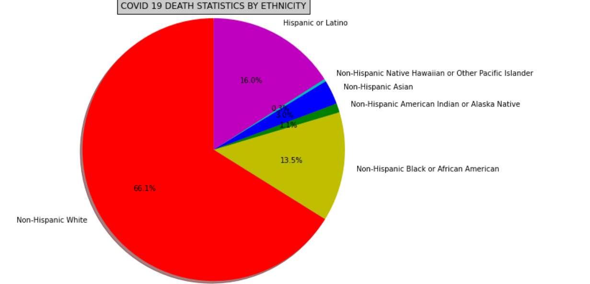
COVID-19 Death Statistics by Ethnicity
Approximately 304824 dead people are White.
304824 dead people are White (~66.1%).
73478 dead people are Hispanic (~16.0%).
62036 dead people are Black (~13.5%).
1182 dead people are Hawaiian (~0.3%).
5056 dead people are American Indian (~1.1%).
13787 dead people are Asian (~3.0%).
For a total of approximately 6 Races/Ethnicities represented.

Slide 19
Sources
Majority of our datasets were sourced from the Center of Disease Control and Prevention (CDC)
covid.cdc.gov/covid-data-tracker/#pregnant-birth-infant
https://covid.cdc.gov/covid-data-tracker/#pregnancy-data
https://covid.cdc.gov/covid-data-tracker/#vaccination-demographics-trends
https://www.kaggle.com/code/therealcyberlord/coronavirus-covid-19-visualization-prediction
https://ourworldindata.org/covid-vaccinations?country=OWID_WRL
https://data.cdc.gov/Vaccinations/COVID-19-Vaccination-Age-and-Sex-Trends-in-the-Uni/5i5k-6cmh/data

